Slide 1
Natural Language Processing
(NLP)
Presenter: YoutengLiang (梁有騰)
Notes:
Good afternoon, everyone, welcome this course, today I will guide you to the world of Nature Language Processing, NLP, We will show you the basic process of NLP, after that we will try to train a model with Keras, the we will try to improve this model, to let you understand the whole process of model building, OK? Let’s get start right now, hope you can bring something out of this classroom

Slide 2
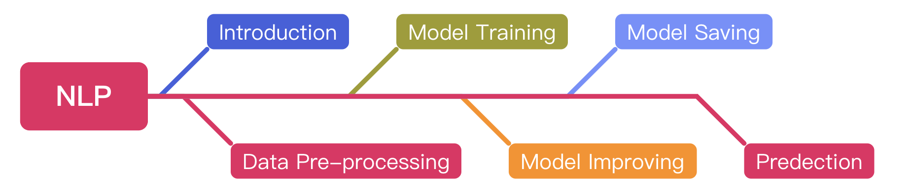
Outline

Slide 3
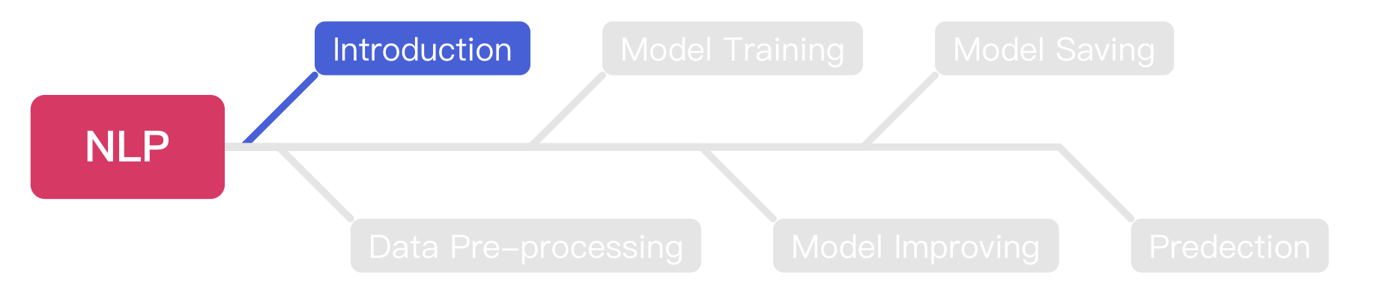
Outline

Slide 4
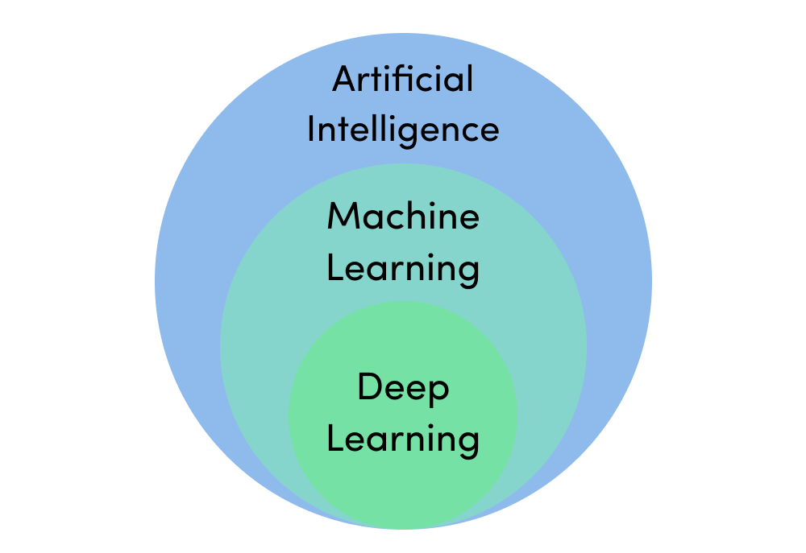
Machine Learning & Deep Learning
https://assets.website-files.com/5fb24a974499e90dae242d98/5fb24a974499e96f7b2431db_AI%20venn%20diagram.png

Slide 5
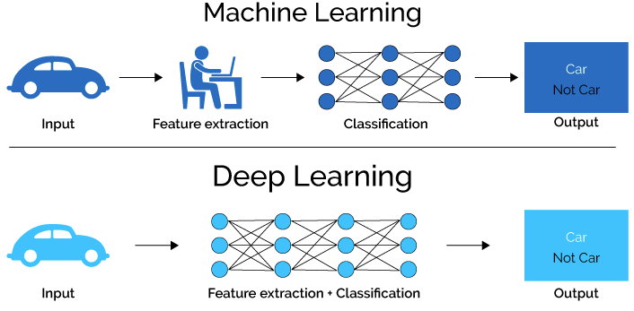
Machine Learning & Deep Learning (Cont’d)
https://medium.com/ai-academy-taiwan/%E7%82%BA%E4%BB%80%E9%BA%BC%E6%A8%A1%E5%9E%8B%E6%9C%83%E9%80%99%E6%A8%A3%E8%AA%8D%E7%82%BA-%E8%A7%A3%E9%87%8B%E7%9A%84%E6%B7%B1%E5%BA%A6%E5%AD%B8%E7%BF%92%E6%96%B9%E6%B3%95%E7%9A%84%E4%BB%8B%E7%B4%B9-%E8%A6%96%E8%A6%BA%E5%8C%96%E7%AF%87-1ac69c627483

Slide 6

Deep Learning Model
https://towardsdatascience.com/converting-a-simple-deep-learning-model-from-pytorch-to-tensorflow-b6b353351f5d

Slide 7
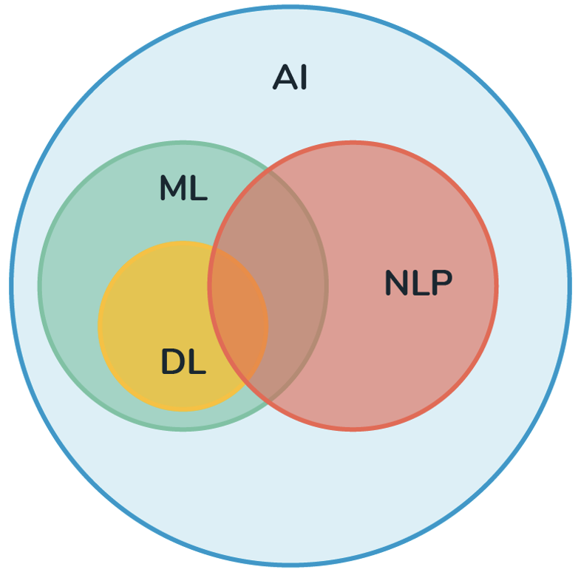
NLP
NLP is stands for Natural Language Processing.
NLP is a subfield of AI.
The main idea of NLP is to make computers understand the human language ex. English or Mandarin.
https://medium.com/@derekliao_62575/%E8%87%AA%E7%84%B6%E8%AA%9E%E8%A8%80%E8%99%95%E7%90%86-nlp-%E5%88%B0%E5%BA%95%E6%98%AF%E4%BB%80%E9%BA%BC-e29ab6356f6d
Notes:
So, let’s see the topic, NLP, what’s NLP means? Does anyone hear about that before? (If yes, let them to explain it.).
NLP is stands for Natural Language Processing, the main idea is to make our computer understand what we are taking about, as we know Natural Language means the languages used by human, for example, English, Mandarin, Japanese, there are so many languages around this world, if our computer can understand what we are talking, then it can understand our commands and able to have corresponding reactions, for example Google assistant, Siri, Alexa…, they are able to understand what we are talking, and give us some reactions, so after this class, perhaps you can try to build your own voice assistant. That will be fascinating.

Slide 8
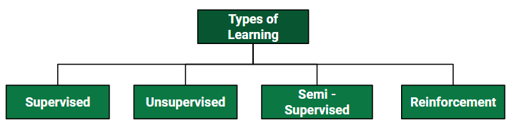
Supervised Learning
Supervised learning is one of method machine learning
The researchers will provide a set of question-answer pairs.
The model will try to figure out the connection between each question and corresponding answer.
After training, this model can answer the questions that never seen before.
https://www.geeksforgeeks.org/ml-types-learning-supervised-learning/

Slide 9
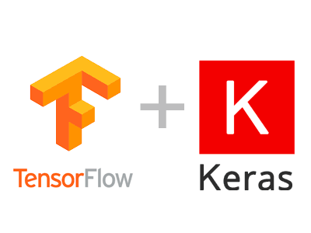
TensorFlow vs. Keras
TensorFlow is a machine learning model build by C++, it can help user to train a machine learning model.
Keras is a package that can help users to invoke TensorFlow easier.
The functions Keras provided can help user to create and train a NN model easier.
https://dsalearning.github.io/tf.keras/2-2-tf-keras-python-dl-env/

Slide 10

Google Colab
Before we start coding, we should know how to use google colab.
Google colab makes you able to write & run python code online.
The most important is Google colab provides free GPU resource for machine learning model training.
https://clay-atlas.com/blog/2019/09/29/colab-chinese-tutorial/

Slide 11
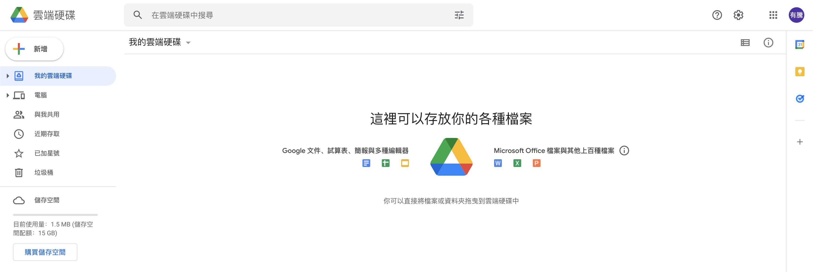
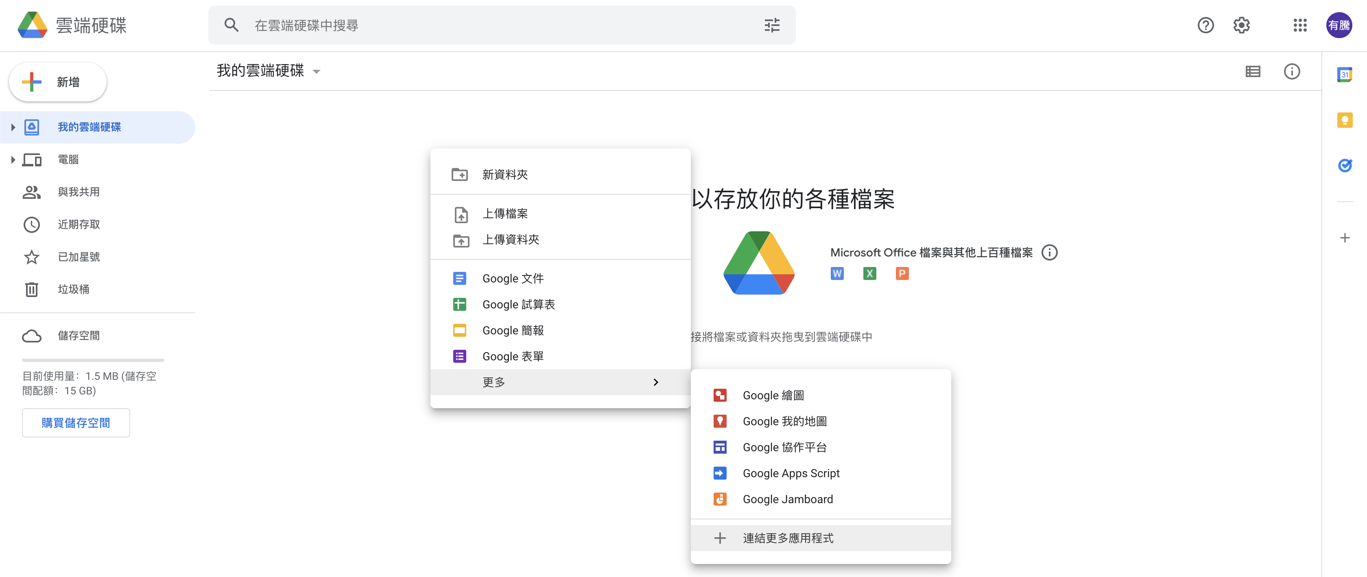
Connect Colab into Google Drive
We should connect colab into google drive before we use it.
Right Click

Slide 12
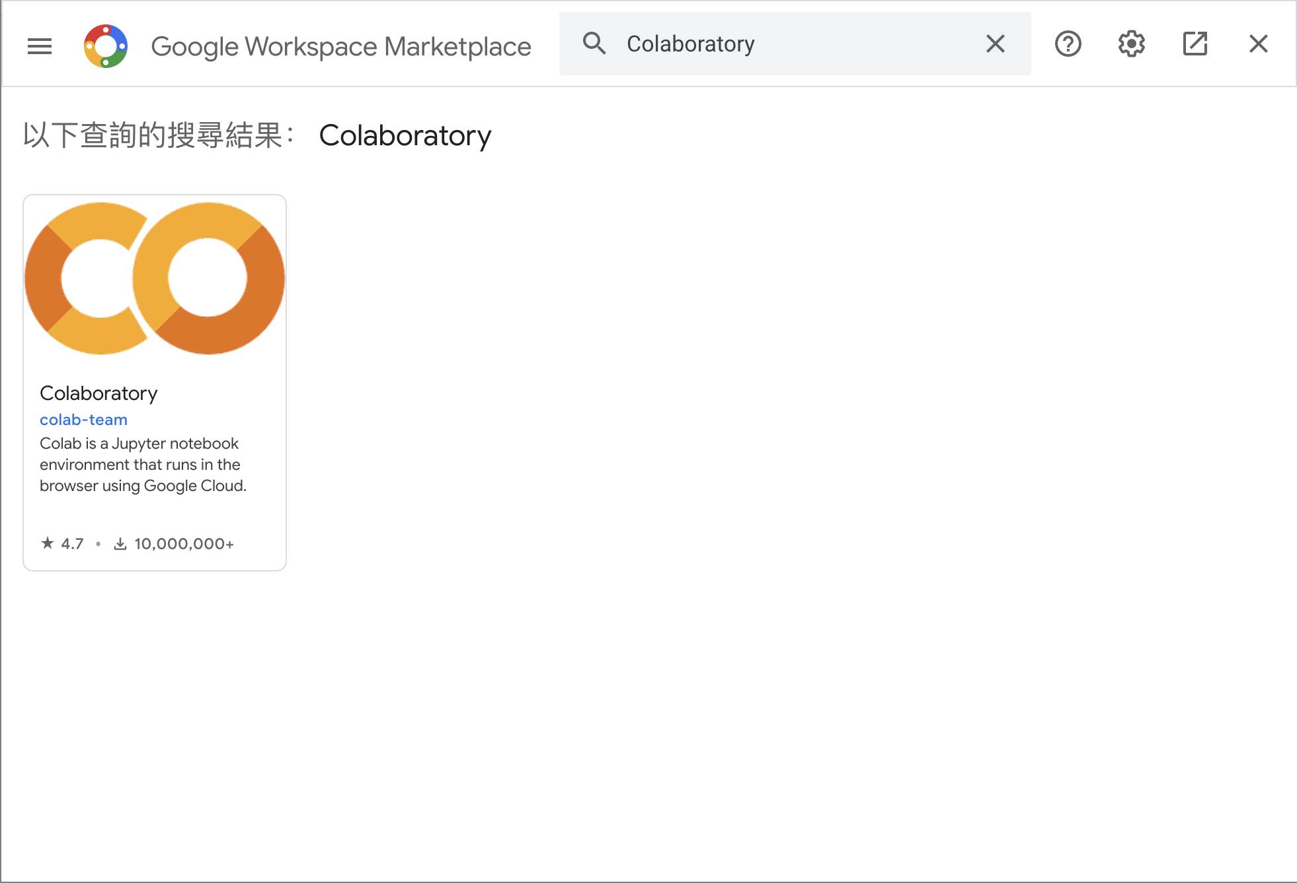

Connect Colab into Google Drive (Cont’d )
Search colab and install it.

Slide 13
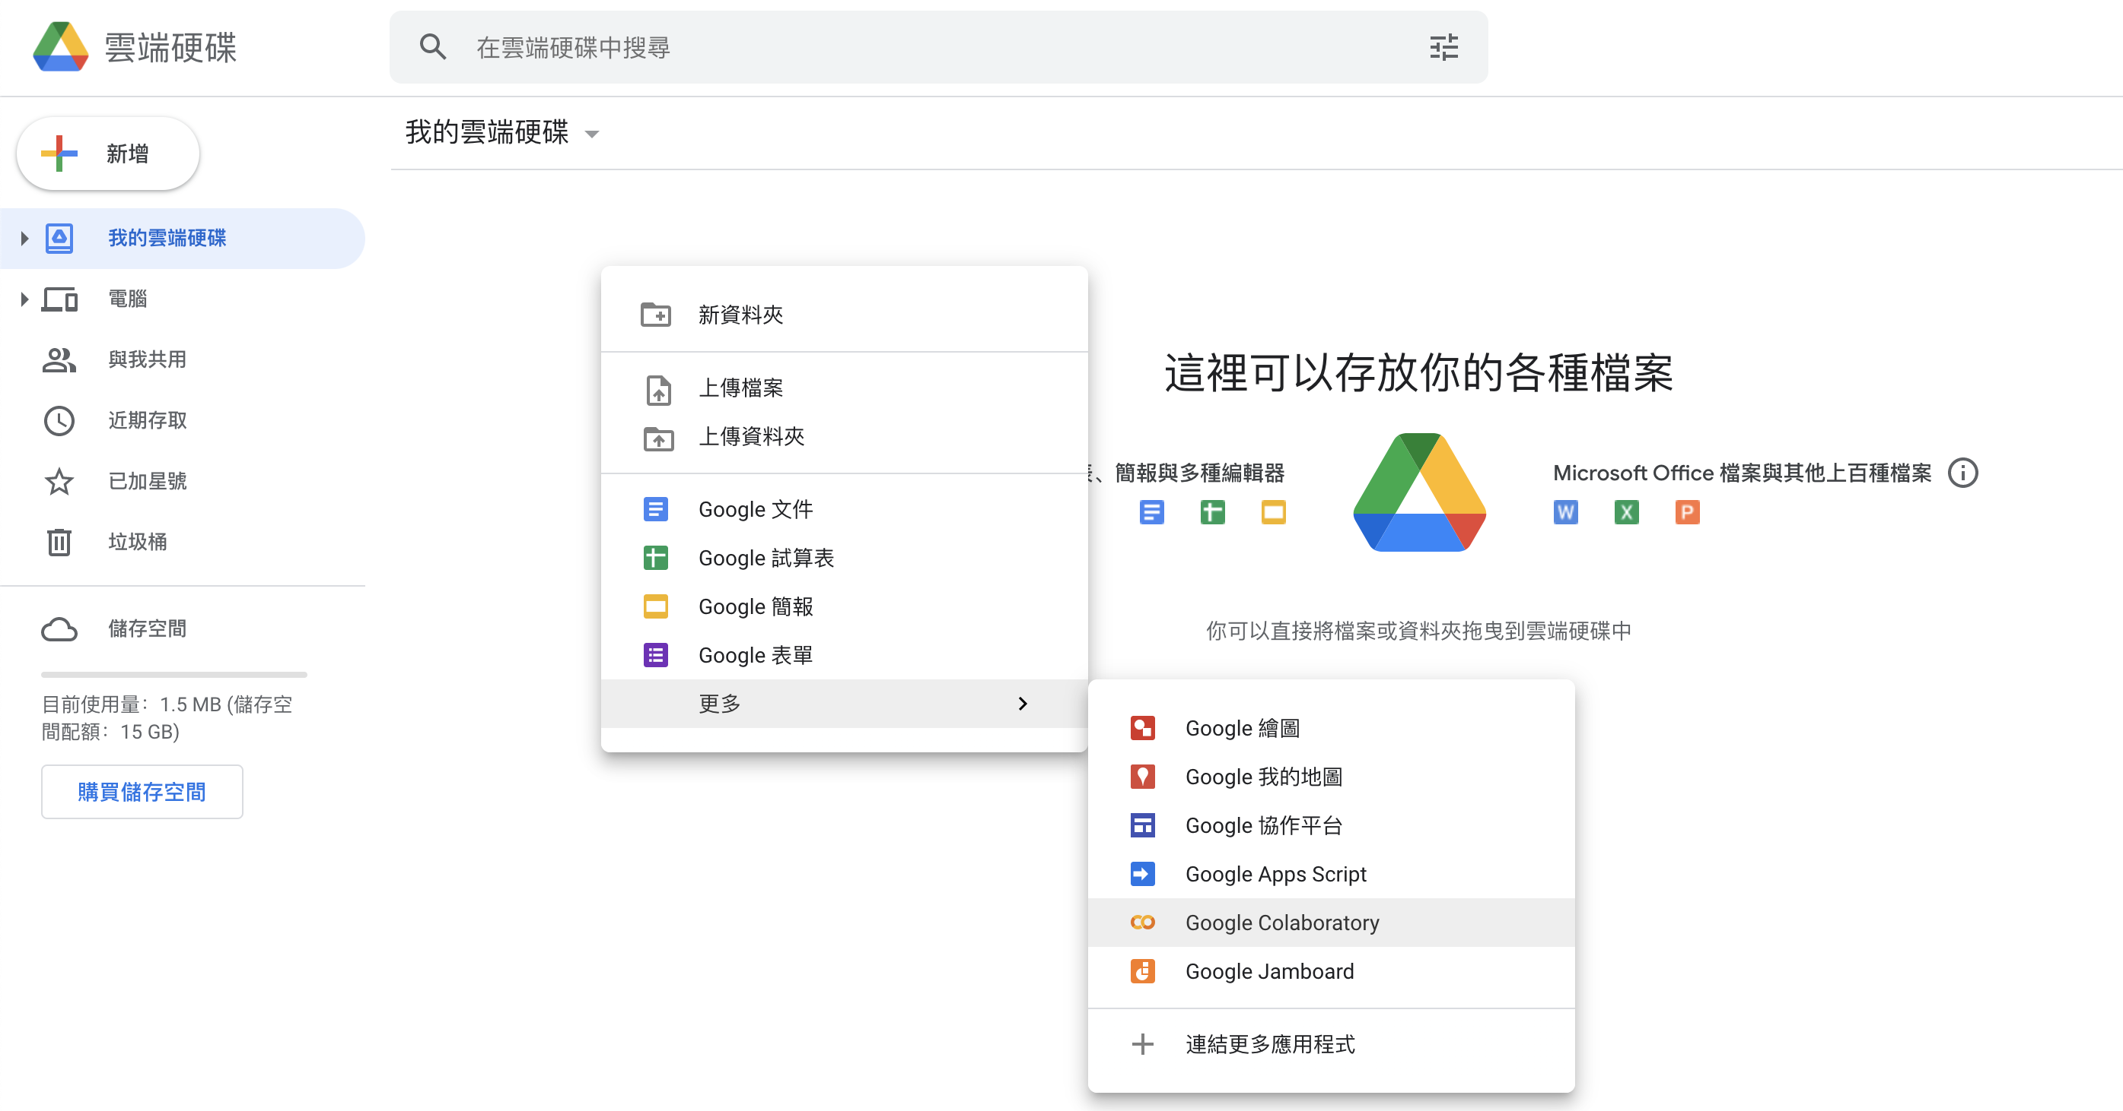
Connect Colab into Google Drive (Cont’d )
After installed, you can create a new colab notebook.

Slide 14
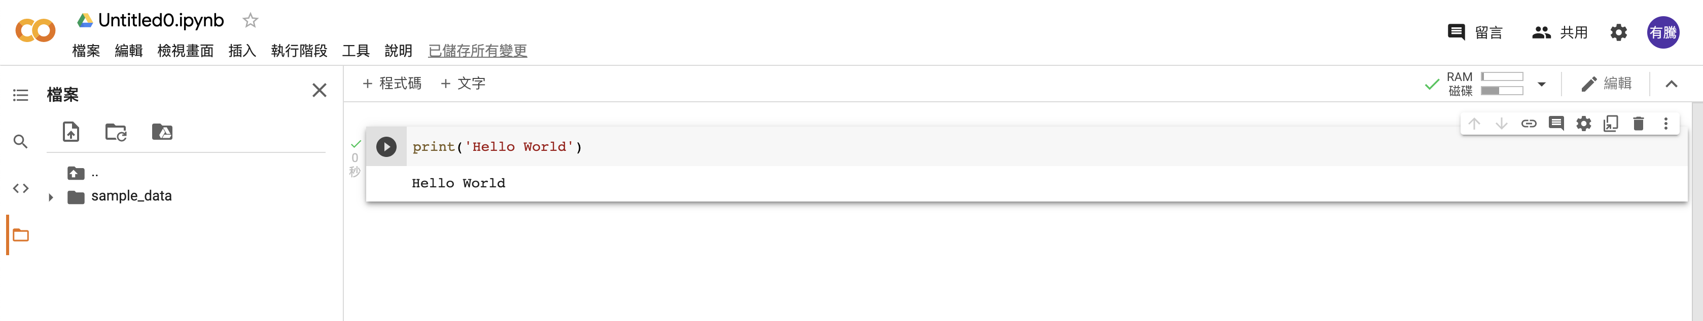
Colab UI
Notebook Name
Code Cell
Python Code
Output
Files
Execute Button

Slide 15
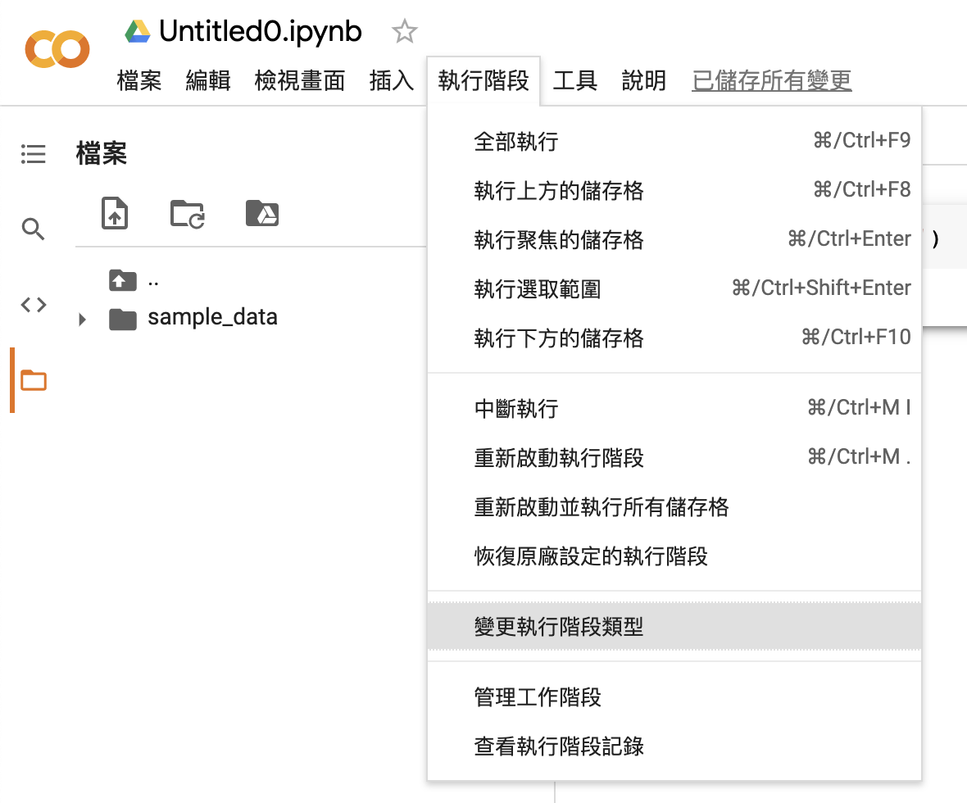
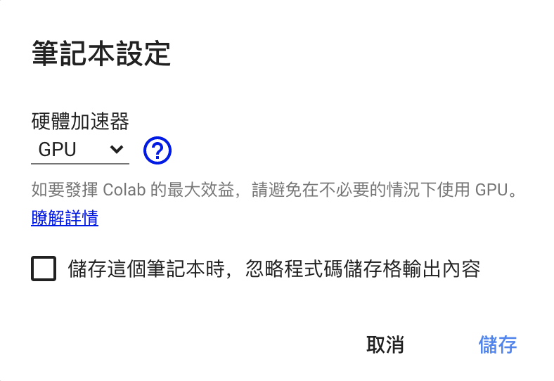
Change to Use GPU
We can change to GPU hardware accelerator.

Slide 16
Tensor Flow Dataset (TFDS)
TFDS is a python model that can help use to get datasets.
Install TFDS with pip.
!pip install tensorflow-datasets
Use load() to load a data set.
tfds.load(“{dataset_name}”)

Slide 17
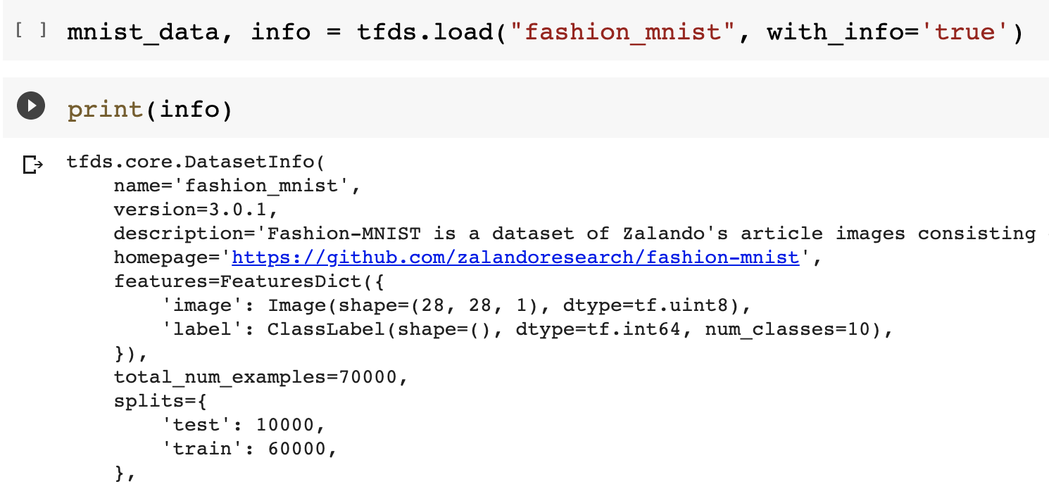
TFDS (Cont’d)

Slide 18

Sarcasm Detection
We are going to build a sarcasm detection model.
This model can help us to classify the sentence sarcasm or not.
We will complete this experiment with Keras.
https://www.wyo.in/pub/media/mf_webp/png/media/catalog/tmp/category/Sarcasm.webp

Slide 19
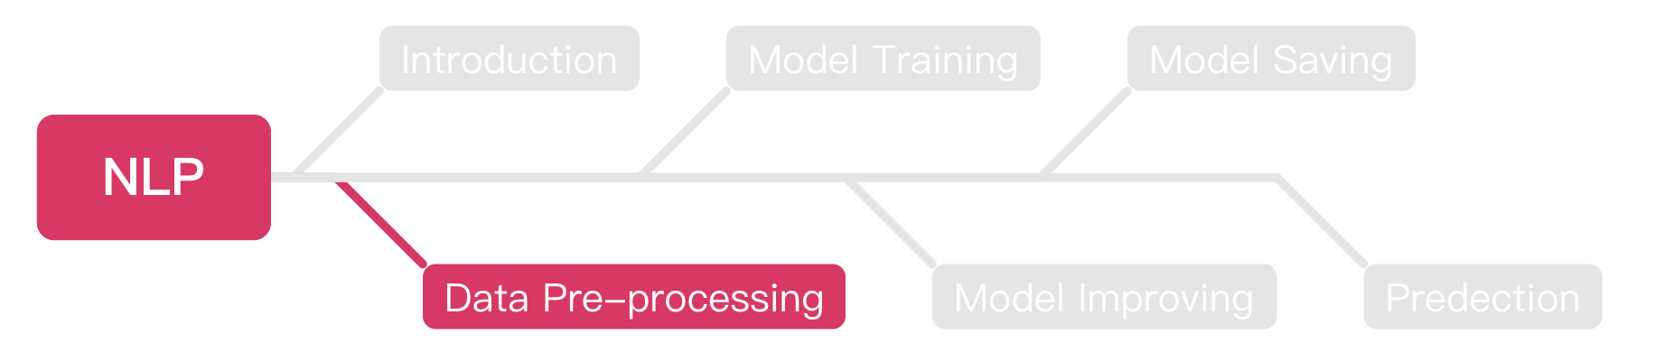
Outline

Slide 20
Tokenization
We can replace the words with numbers in a sentence.
“I love dog” = [1, 2, 5]
“I love cat” = [1, 2, 3]
“I love a cat” = [1, 2, 4, 3]

Slide 21
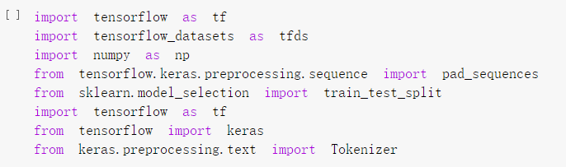
Import Packages

Slide 22
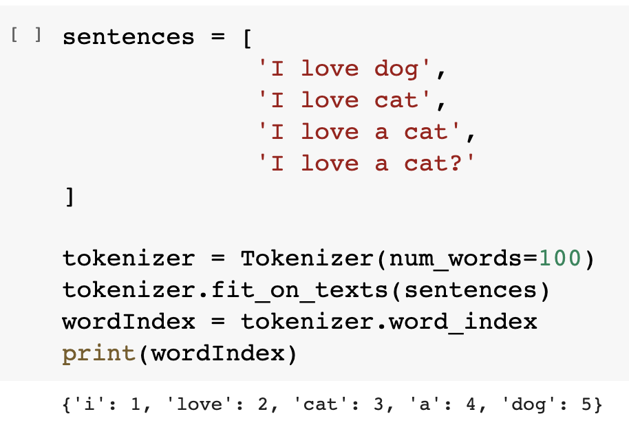
Tokenization (Cont’d)
We can use python package to do the tokenization easily.

Slide 23
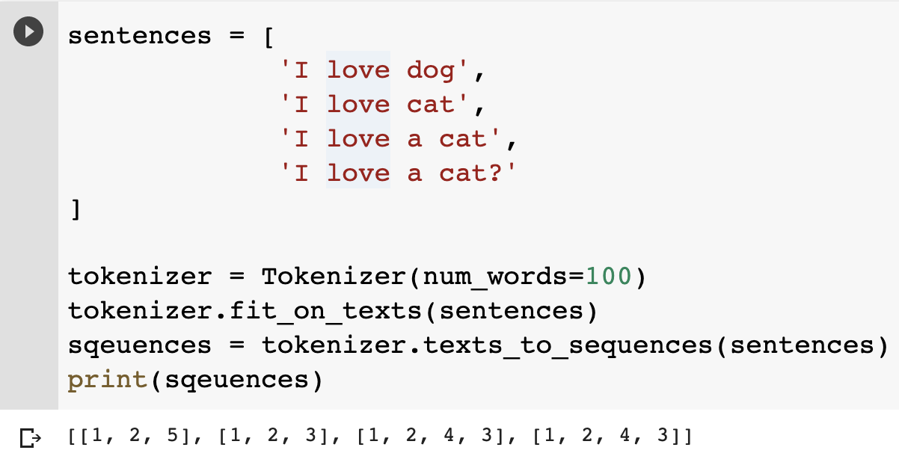
Texts to Sequences
We should combine the IDs with the sentences.

Slide 24
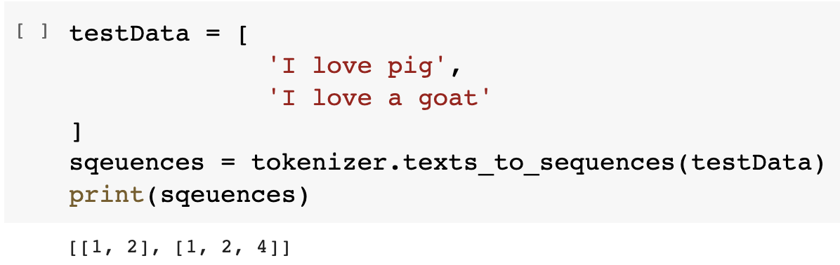
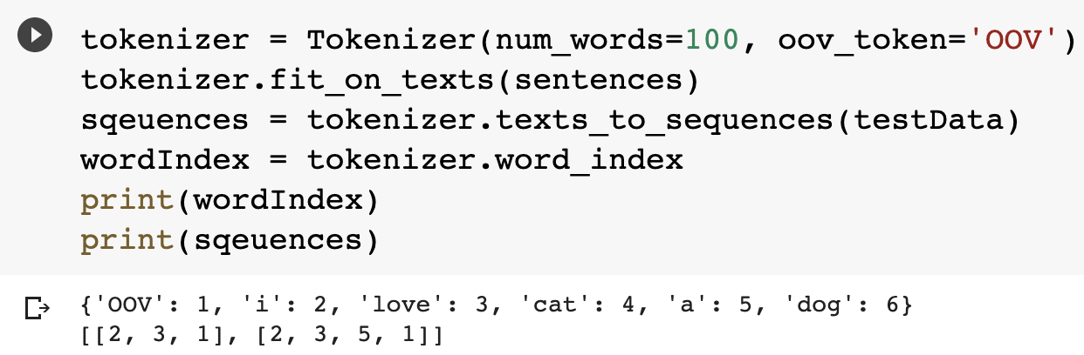
Out of Vocabulary (OOV)
OOV means your algorithm can’t understand the word, it means this word doesn’t exist in the vocabulary.

Slide 25
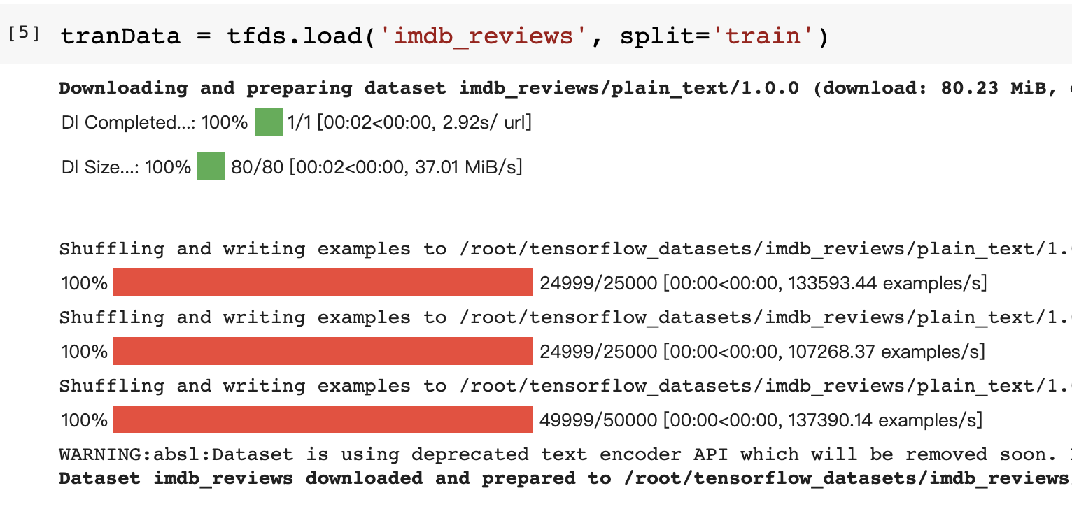
Get Texts from TensorFlow
We can get the texts from TensorFlow.

Slide 26
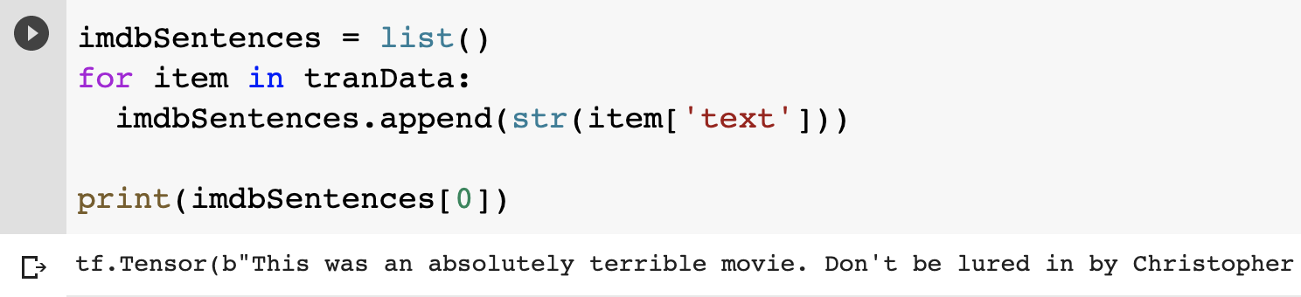
Get Texts from TensorFlow (Cont’d)
After loaded, we can append each sentence into a list.
We can try to print the first data.

Slide 27
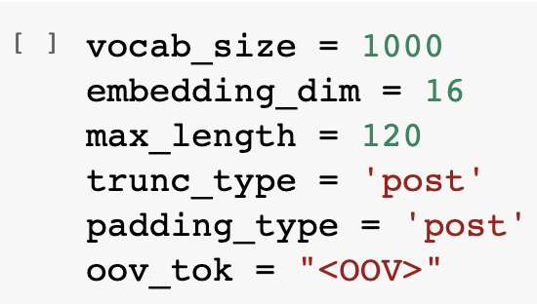
Parameters Declaration
These parameters will be use during our model train part, you can try to set it to different value and observe the differences.

Slide 28
Sarcasm Dataset
From now on, we will start to build a model for sarcasm detection.
We should do data pre-processing before to build a ML model.
Basically, the datasets will be provided in .json or .csv file format.
The format of example dataset is .json, but practice data set will be .csv, please try to practice how to load these two different file format.

Slide 29
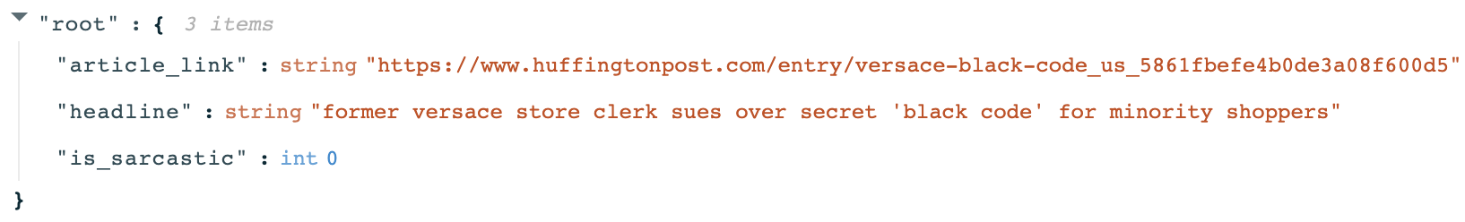
Sarcasm Dataset (Cont’d)
The following is the format of the sarcasm dataset as .json file, you should load and categorize all data as well.

Slide 30
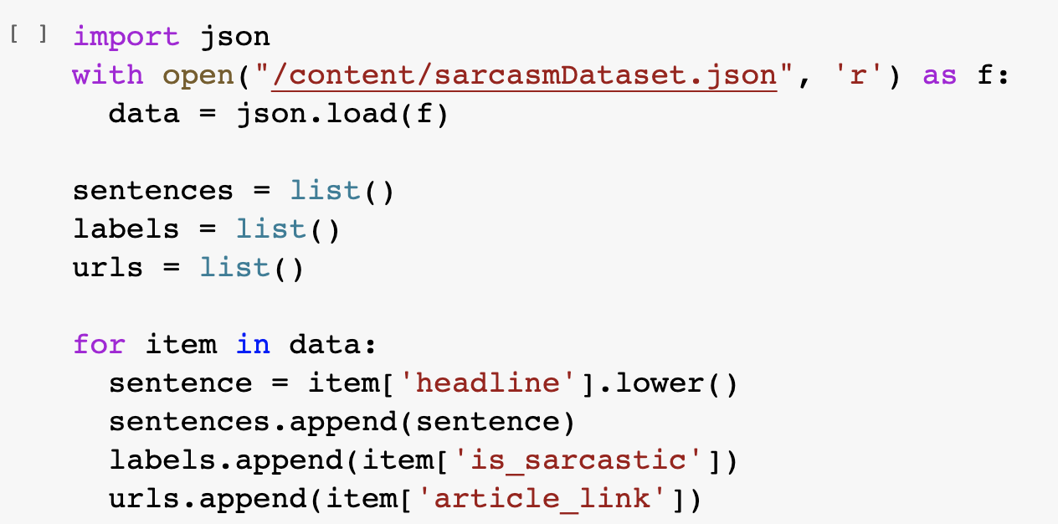
Load Data from Json File
The following is the process of loading dataset form .json file.

Slide 31
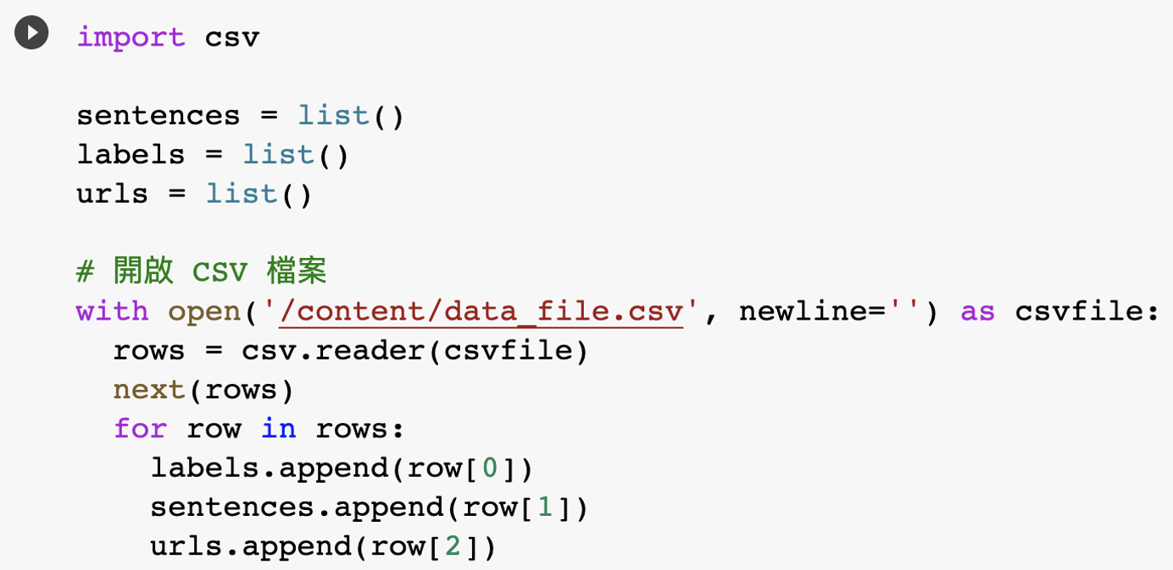
Load Data from CSV File
You can load the data from CSV file with these steps:

Slide 32
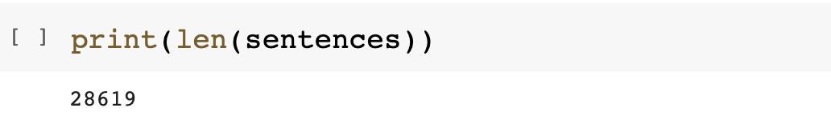
Amounts of Data
We can use len() to observer the size of data that intended to train.
Obviously, len() says we have 28619 data loaded from .json dataset.

Slide 33
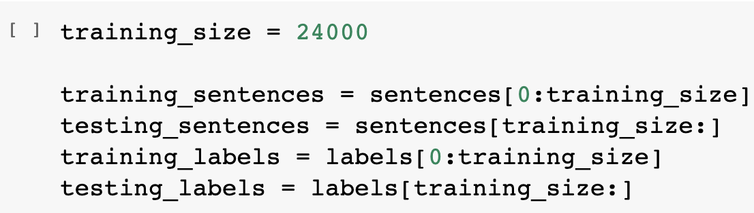
Split Dataset into Training and Testing
Since the dataset didn’t provide us the testing data, we should split it from origin dataset ourself.
We choose 24000 data for training and 4619 for testing.

Slide 34
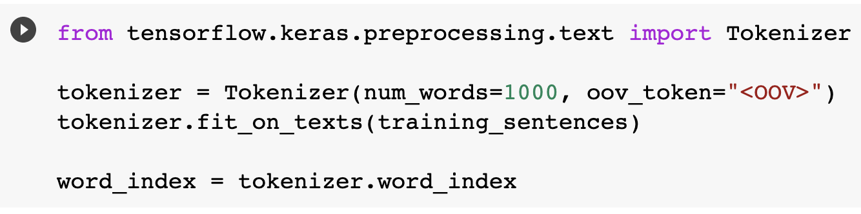
Tokenizing the Data
We should transfer our data from NLP to word index before training.
We can use fit_on_texts() to transfer it easily.

Slide 35
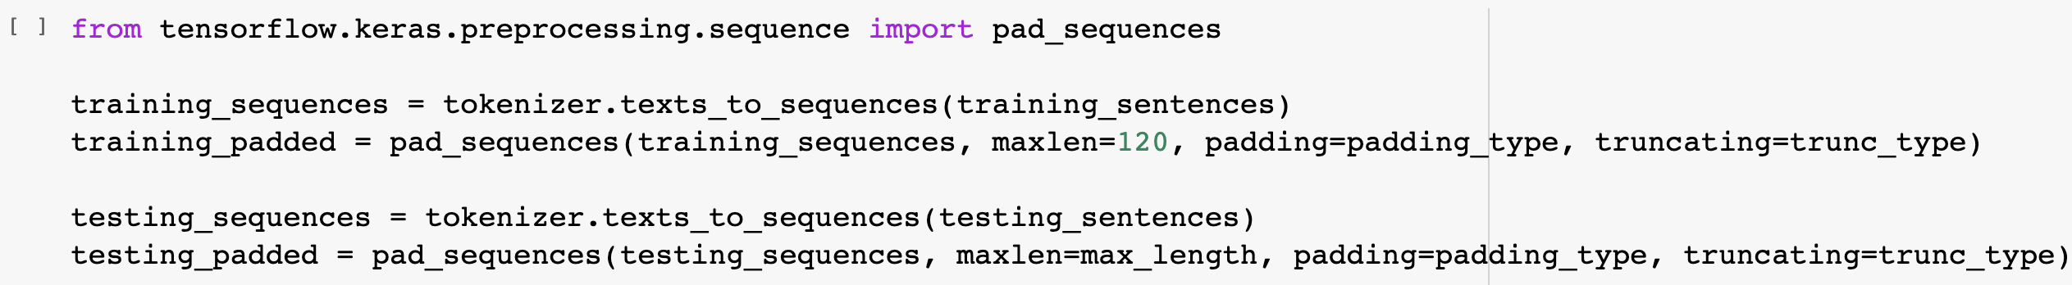
Pad Sequences
We should do pad sequences after tokenization.
The main idea is make sure all data have same length.
Keras provides a simple method pad_sqeuences() to do that.
1 2 3 4 5 6
1 2 3 0 0 0
1 2 0 0 0 0

Slide 36
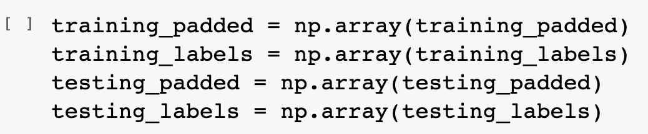
Turn the Data into Numpy Array
There’s one thing we should do before training, transfer all data into Numpy array.
Since all parameters in Keras are Numpy array, we should transfer our data as well
Simple, just call np.array() to transfer your data.

Slide 37
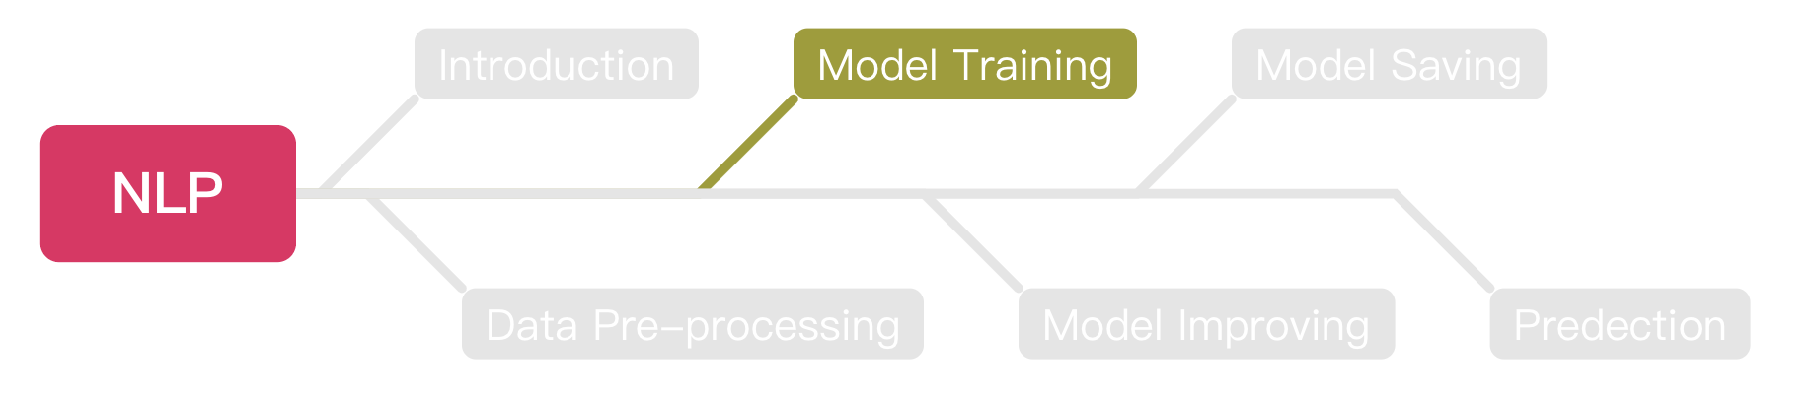
Outline

Slide 38
Embedding
At the beginning, each word has a sarcasm score 0.
The score will +1 if that sentence is labeled as sarcasm, -1 if not.
After thousands of rounds, we can get a final score of each word.
Calculate the total score of each sentence.
If the score > 0, we say this sentence is sarcasm.

Slide 39
Embedding (Cont’d)
There are two sentences “You love dog” and “How nice you are”.
We set “You love dog” as not sarcasm, “How nice you are” as sarcasm.
We know all words have 0 point at the beginning.
So, we can get the score of each word like below:
[you: 0, love: -1, dog: -1, how: 1, nice: 1, are: 1 ]
The score of ”you” will be like -1 + 1 = 0.
We can get the score of “How a nice person” as 1 + 0 + 1 + 0 = 2.
So we can say “How a nice person” is a sarcasm sentence.

Slide 40
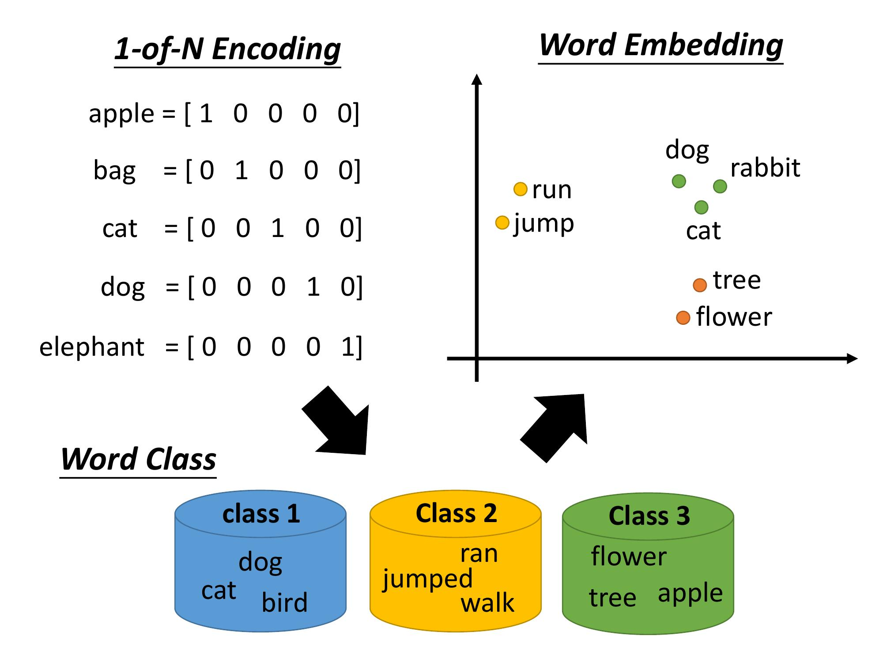


Embedding (Cont’d)
After embedding, we can get the vector of each word.
https://ai.ntu.edu.tw/resource/handouts/ML14.html

Slide 41
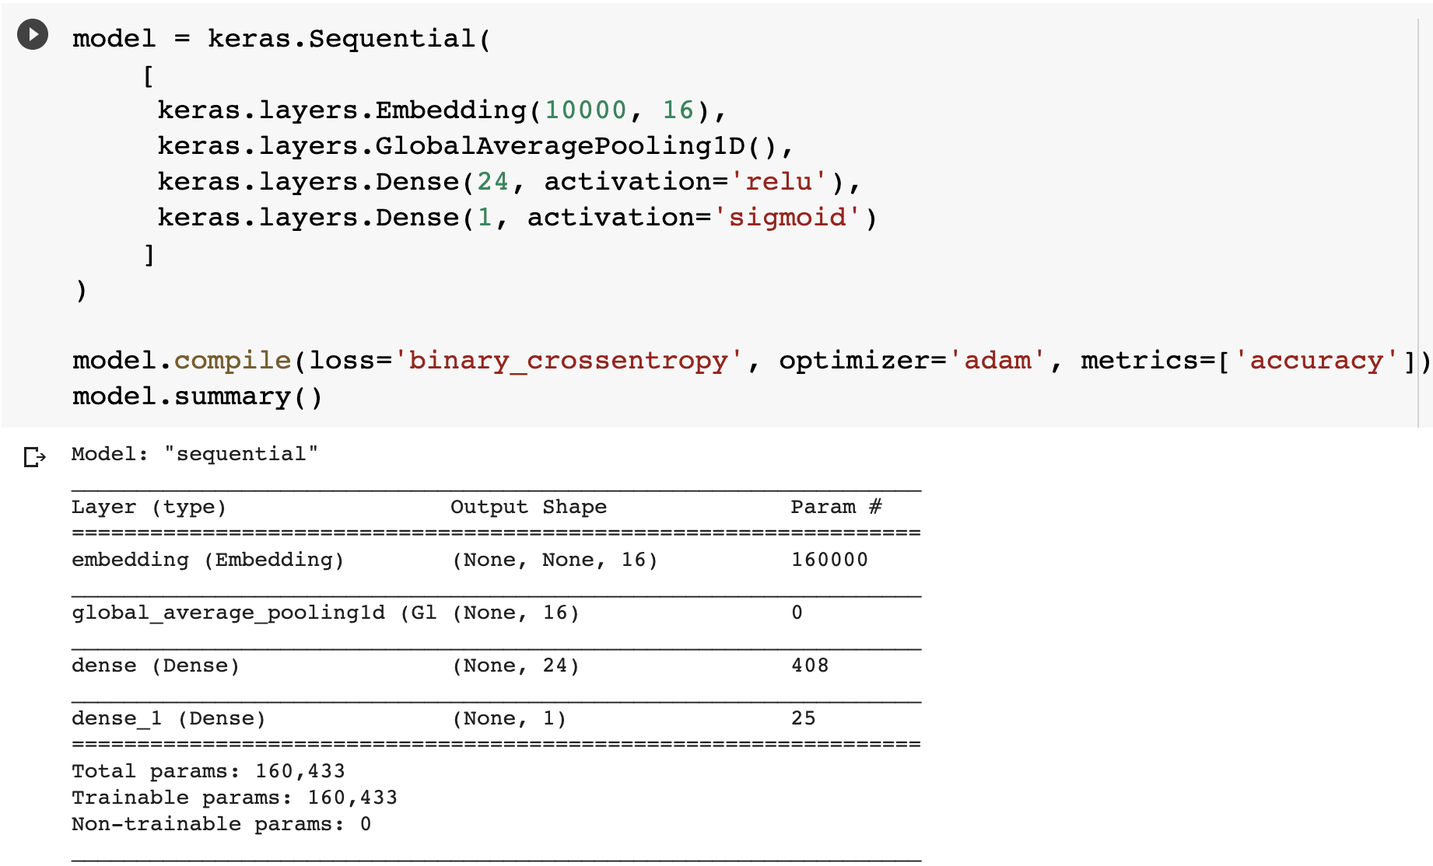
Building the Model

Slide 42
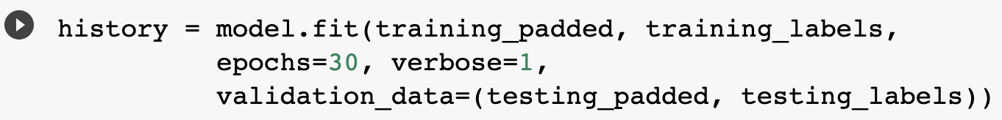
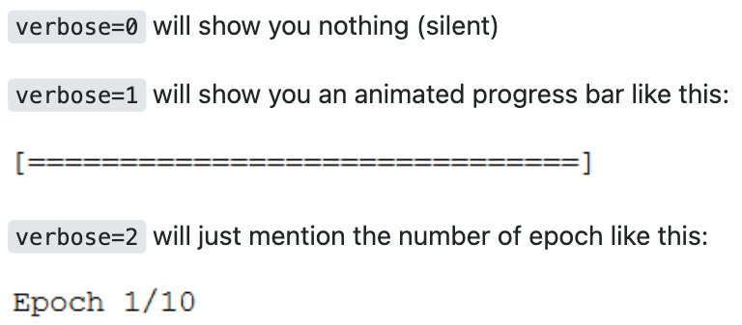
Training the Model
https://stackoverflow.com/questions/47902295/what-is-the-use-of-verbose-in-keras-while-validating-the-model

Slide 43
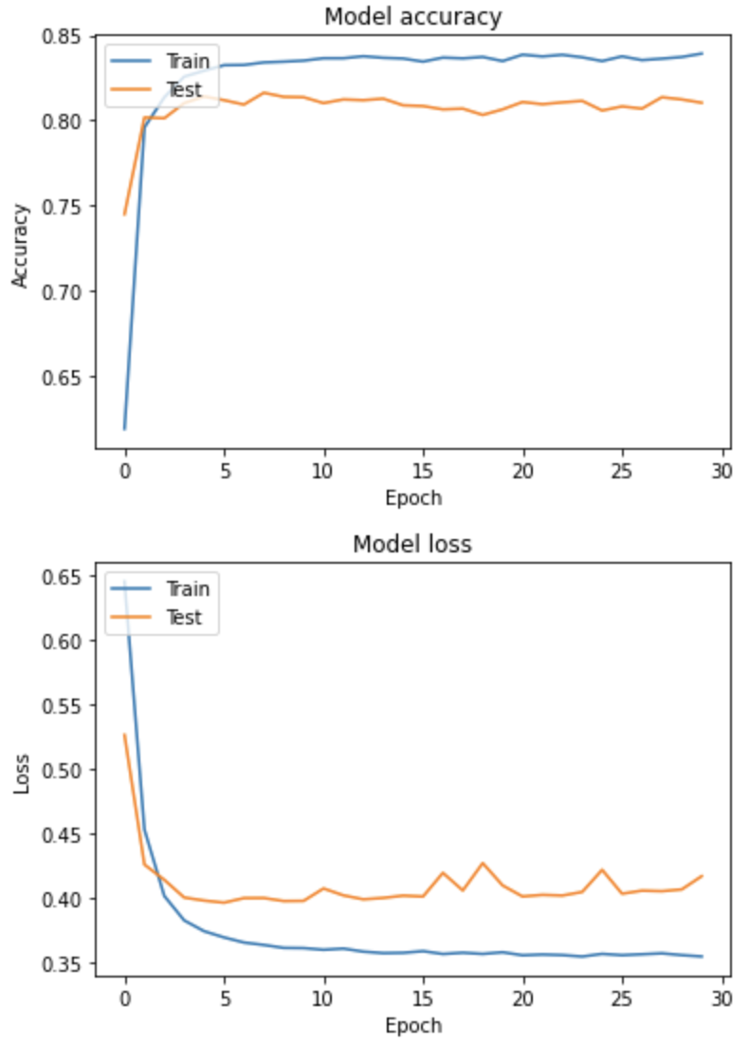
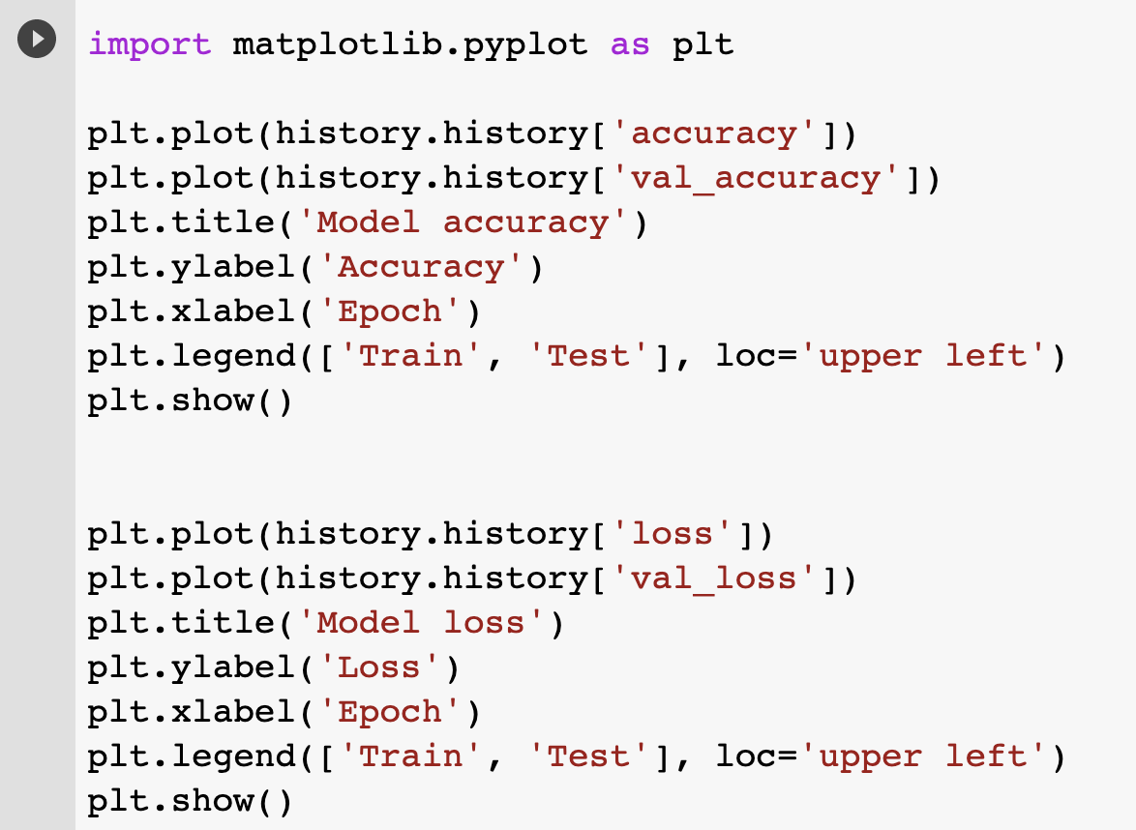
Plotting the Results

Slide 44
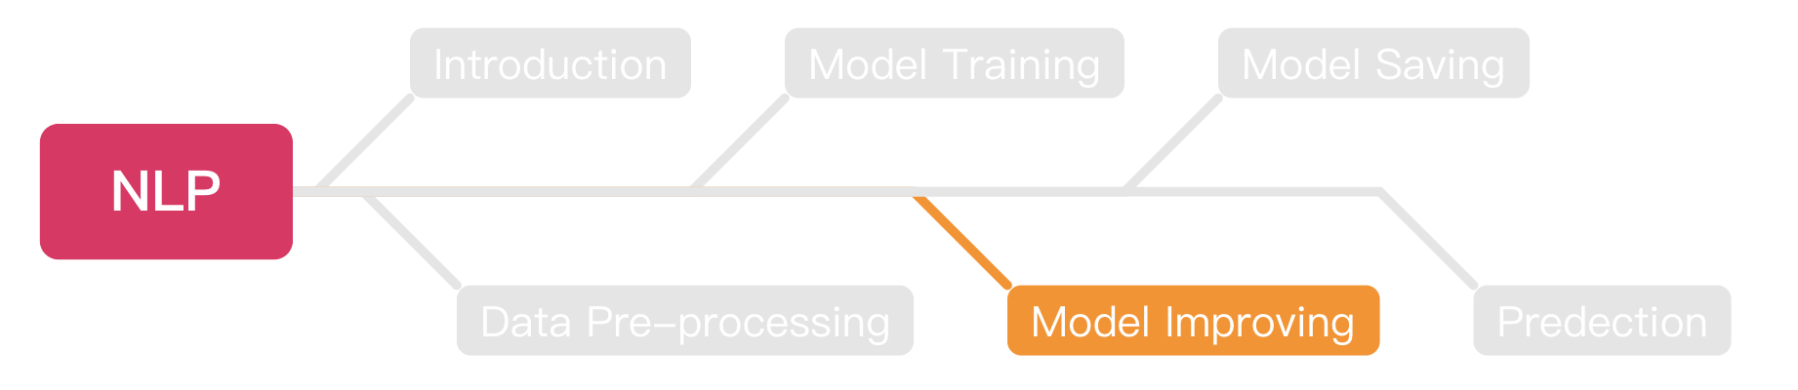
Outline

Slide 45
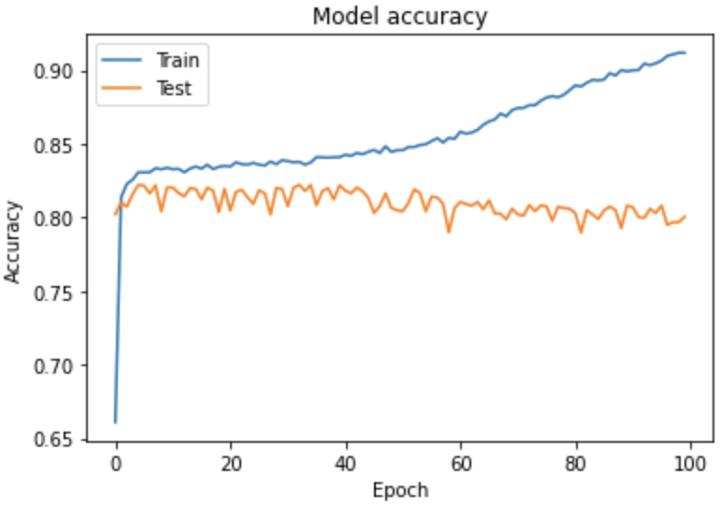
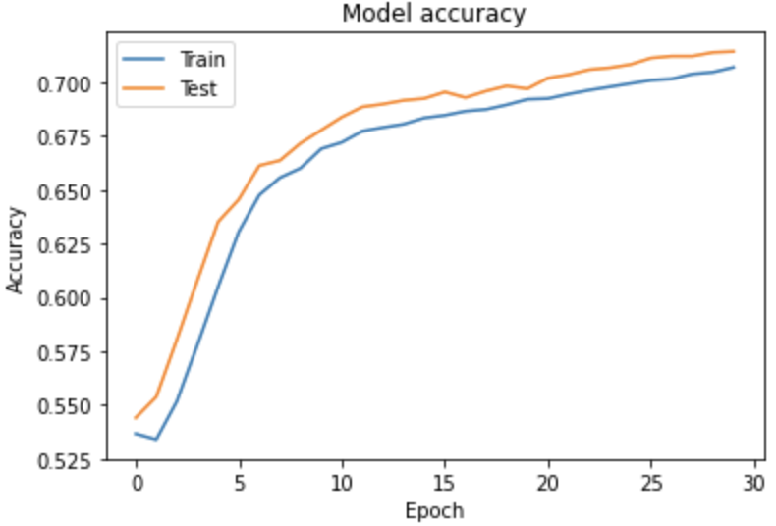
Before Model Improving
We should know these two different status before model improving
Overfitting
Underfitting

Slide 46
Overfitting
Overfitting is a problem that will happened during training your model.
The train accuracy gets higher but the validate accuracy remain the same or even lower.
Try to imagine if your model just memorize all the answers, how it will be if the question in test set has a little bit change?

Slide 47
Underfitting
Underfitting means your model can do better.
If you stop training when your model is growing, that will cause underfitting.
You should increase the epochs or the layer amounts to exploit the model to avoid underfitting.

Slide 48
Improving our model
After we know how to train our model, next step is to improve it.
We will try these ways to improve our model:
Increase the training epochs.
Add more hidden layers.
Use another NN for training.
Use pre-trained model (Transfer learning).
Increase the amounts of data.
Improve the optimizer.

Slide 49
Improving Model
Increase the training epochs.
Add more hidden layers.
Use another NN for training.
Use pre-trained model (Transfer learning).
Increase the amounts of data.
Improve the optimizer.

Slide 50
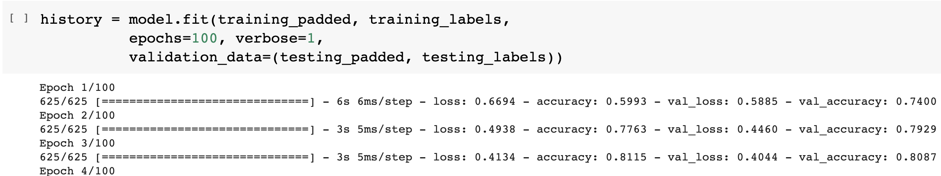
Improving the Epochs
The simplest way to try is improve the training epochs.
For example, increase from 30 to 100.

Slide 51
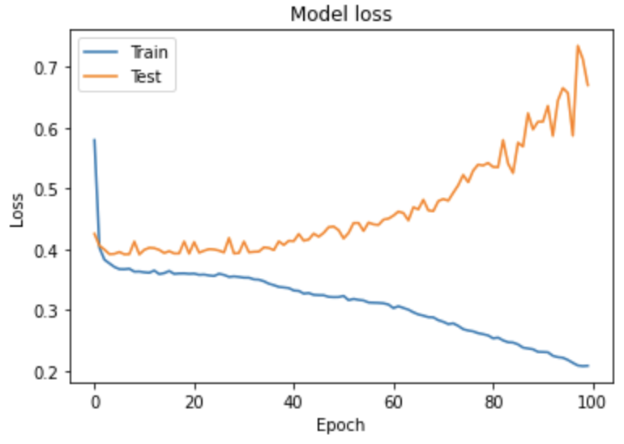
Improving the Epochs (Cont’d)
Let’s see the results.
Overfitting

Slide 52

Next Steps
https://medium.com/initialized-capital/we-need-to-go-deeper-a-practical-guide-to-tensorflow-and-inception-50e66281804f

Slide 53
Improving Model
Increase the training epochs.
Add more hidden layers.
Use another NN for training.
Use pre-trained model (Transfer learning).
Increase the amounts of data.
Improve the optimizer.

Slide 54
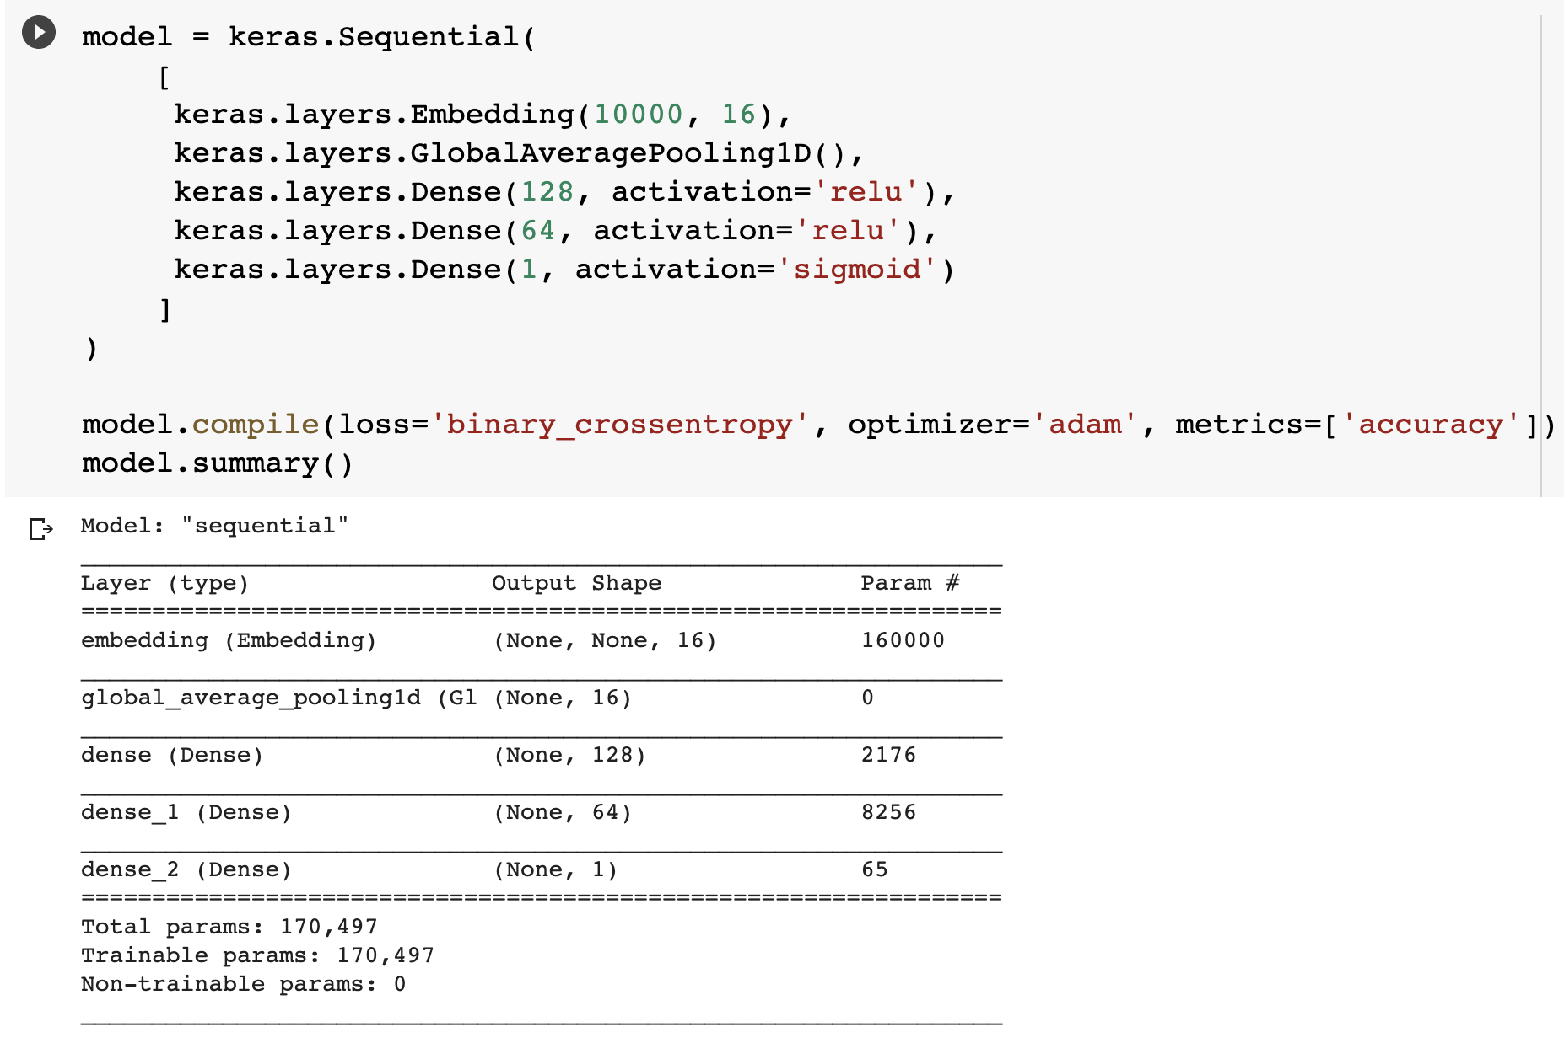
Training with More Hidden Layers

Slide 55
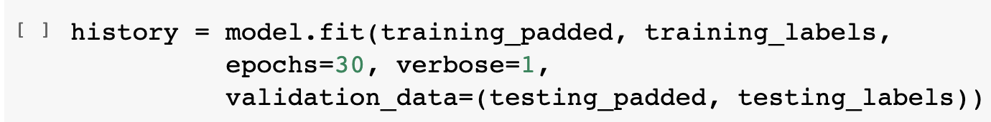
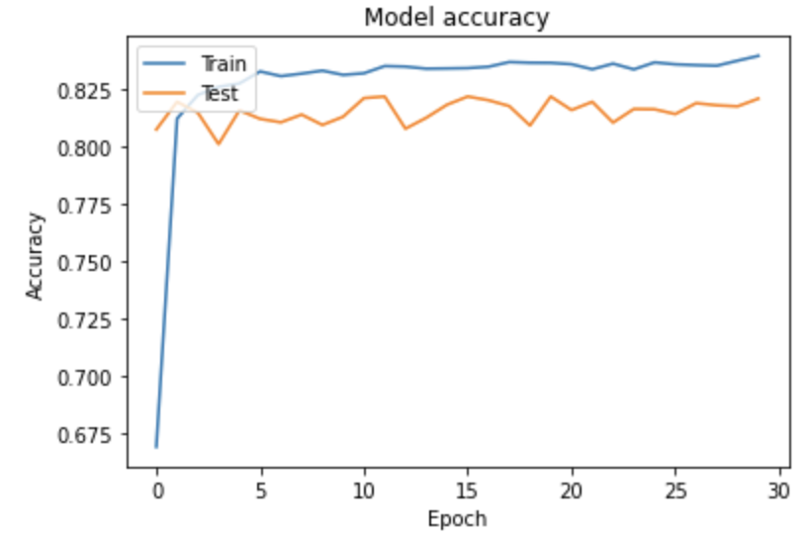
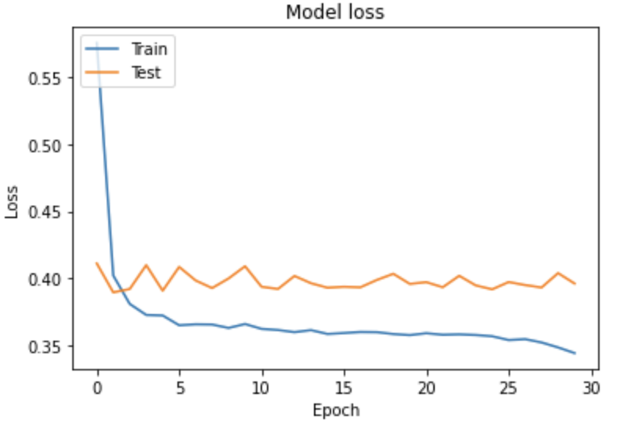
Training with More Hidden Layers (Cont’d)

Slide 56
Improving Model
Increase the training epochs.
Add more hidden layers.
Use another NN for training.
Use pre-trained model (Transfer learning).
Increase the amounts of data.
Improve the optimizer.

Slide 57
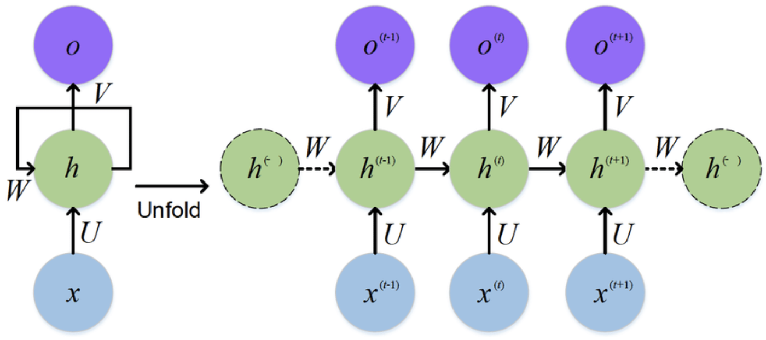
RNN
RNN means recursively neural network.
RNN is one of the popular NN models, the characteristic is RNN will re-train the model with new data.
https://www.researchgate.net/figure/The-standard-RNN-and-unfolded-RNN_fig1_318332317

Slide 58
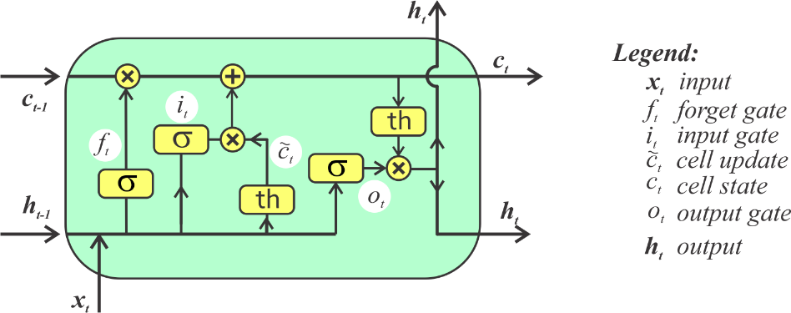
Long Short Term Memory
LSTM is the most popular implementation of RNN.
The simple way to understand LSTM is:
It will re-train the data with new data.
It will dropout the data that is not important.
It has a gate to determine if the data can be output to next layer.
https://www.rs-online.com/designspark/lstm-cn

Slide 59

Training Model with LSTM
We can use the build-in LSTM layer of Keras to train our model.

Slide 60



Training Model with LSTM
Let’s see the results.

Slide 61
Improving Model
Increase the training epochs.
Add more hidden layers.
Use another NN for training.
Use pre-trained model (Transfer learning).
Increase the amounts of data.
Improve the optimizer.

Slide 62
Pre-trained Model
This pre-trained model provided by Google.
This pre-trained model has 130 GB corpus of English Google News.
You can see the detailed information in this website.
https://tfhub.dev/google/tf2-preview/gnews-swivel-20dim/1

Slide 63

Pre-trained Model (Cont’d)
Now we are trying to invoke the pre-trained model.
Luckily, this pre-trained model is included in TensorFlow Hub.

Slide 64

Training the Data with Pre-trained Model

Slide 65


Training Results

Slide 66
Training Results (Cont’d)
We can see that, the overfitting problem is fixed.
But seems the accuracy is not so good.
The accuracy is under 70%.

Slide 67
Improving Model
Increase the training epochs.
Add more hidden layers.
Use another NN for training.
Use pre-trained model (Transfer learning).
Increase the amounts of data.
Improve the optimizer.

Slide 68
Training with More data
Since the data we have is not enough.
We should standing on the shoulders of giants.
Let’s use GloVe to train our model.
GloVe collects more than 2 billion tweets on Twitter.
The dataset more than 1.4 GB!

Slide 69

Downloading GloVe Dataset
We can download the dataset with a simple Linux command.
Or, you can download it via this link.
https://huggingface.co/stanfordnlp/glove/resolve/main/glove.twitter.27B.zip

Slide 70

Unzipping the Dataset
Python zipfile package can help you to zip or unzip files.
Always remember to close file stream after your works done.

Slide 71

Loading the Data
Now, let’s try to load the data from the dataset.
We choose to use glove.twitter.27B.25d.txt this file.
It means it has 27 billion of tokens and each token has 25 dimensions.

Slide 72

Try to Print the Coefficients
After we loaded the data, we can try to print the coefficients.

Slide 73

Filter the Data
Since this dataset is too large, it will take lots of time for training.
We just take what we need.

Slide 74

Preparing the Model

Slide 75

Training the Model
First, we juts train it with 30 epochs to see the results.

Slide 76


Results
Well, I don’t like the results.

Slide 77
Improving Model
Increase the training epochs.
Add more hidden layers.
Use another NN for training.
Use pre-trained model (Transfer learning).
Increase the amounts of data.
Improve the optimizer.

Slide 78

Optimizer
Don’t worry, we still the last skill.
Modify the optimizer.
https://zhenglungwu.medium.com/pytorch-optimizers-03-adam-adamax-f8f53429dc1d

Slide 79

Optimizer (Cont’d)

Slide 80

Optimizer (Cont’d)
https://blog.paperspace.com/intro-to-optimization-momentum-rmsprop-adam/

Slide 81

Learning Rate
We can see that if we should have optimal learning rate.
It means we can’t let our model learn too fast or too low.
https://ithelp.ithome.com.tw/m/articles/10204032

Slide 82

Results
Underfitting

Slide 83


Results of 50 Epochs

Slide 84


Results of 70 Epochs

Slide 85
Results
Seems 50 epochs is the best solution.
Next step is to save our model.

Slide 86

Outline

Slide 87

Save the Model
You can save your trained model for next time prediction with these steps.

Slide 88

Outline

Slide 89

Loading Saved Model to Predict
You can load the local model with simple steps:
After loaded, this model can be used for prediction.

Slide 90

Pre-processing
We should do the same steps to the data we intended to predict as the training data.
Just do that quickly.

Slide 91
Pre-processing (Cont’d)
Keep doing the pre-processing of our data.

Slide 92

Prediction
You can do the prediction with:
Just one step, does it easy enough?

Slide 93

Exercise
We prepare two datasets for you to train your own model, both are stored as .csv file.
Of course, you can do the exactly same this with us to build a workable model, but I pretty sure it will be fascinating if you build your own one with difference method.
Link to datasets: https://drive.google.com/drive/folders/1kwORuSfpuPlqKKLFc3rhT0nHusqA6EzF?usp=sharing

